Slide 1
Convolutional and reurrent neural networks
Some from: Amir Hesam Salavati’s DS course Some from: https://web.stanford.edu/~jurafsky/slp3/

Slide 2
Convolutional Neural Networks

Slide 3
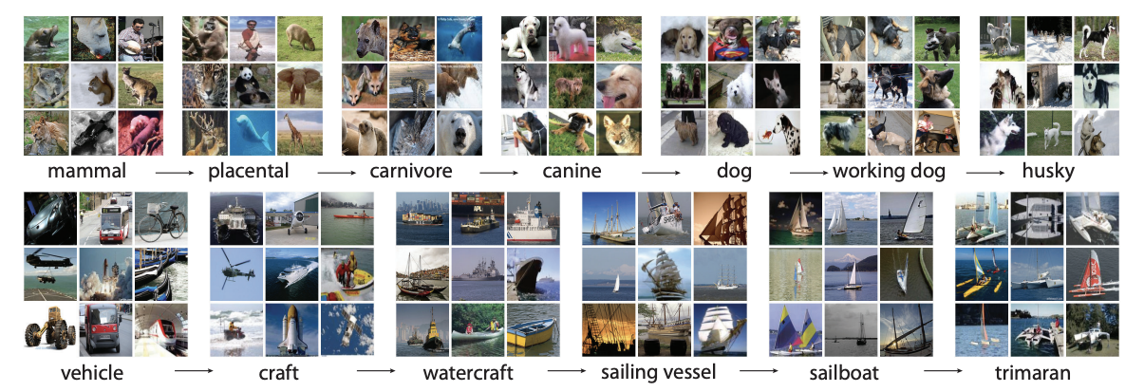
ImageNet Dataset
More than 14 million annotated images
More than 20,000 categories
Image: https://blog.roboflow.com/introduction-to-imagenet/

Slide 4
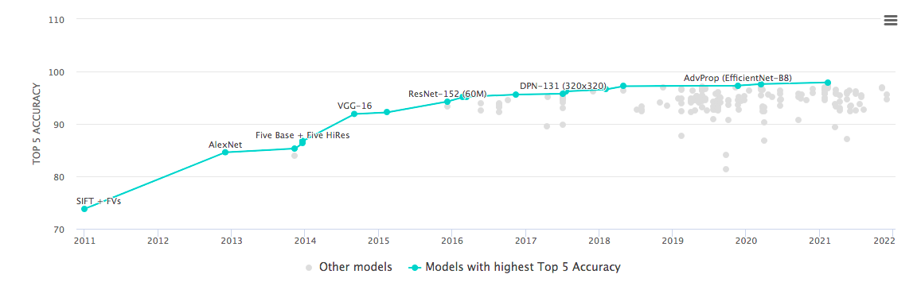
ILSVRC: ImageNet Large Scale Visual Recognition Challenge
Using only 1000 classes out of 20,000+, predict the class of image
Top-5 accuracy: the actual class is among the top 5 predicted by the algorithm
Source: https://paperswithcode.com/sota/image-classification-on-imagenet?metric=Top%205%20Accuracy

Slide 5
ILSVRC: ImageNet Large Scale Visual Recognition Challenge
2012: AlexNet improving the score massively, triggering interest in convolutional neural networks
From ~74% to ~85%
2014: GoogleNet reaches 93.3% accuracy in top-5 category prediction
Really expert humans usually get to around 95%
Ordinary people do much worse!
2021: State of the arts reaches above 97.5% accuracy
Hence the term “better than human vision”

Slide 6
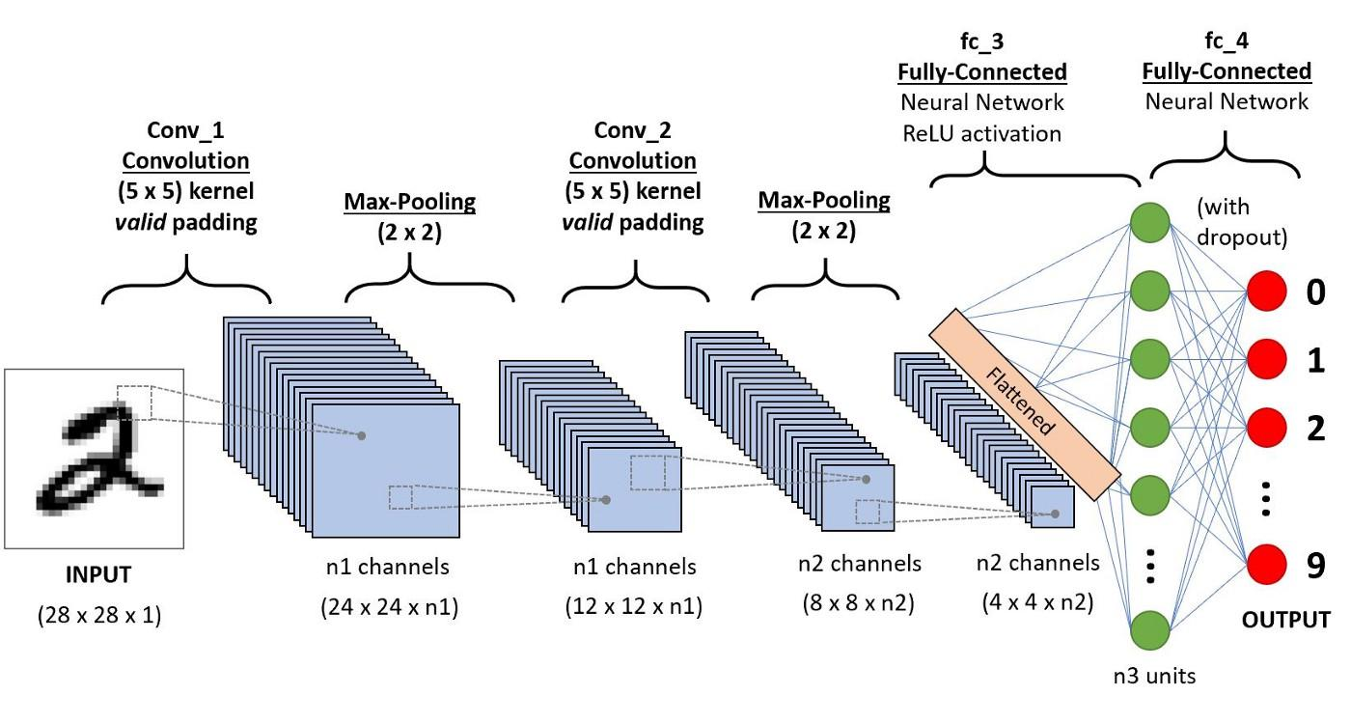
Convolutional Neural Networks
https://towardsdatascience.com/a-comprehensive-guide-to-convolutional-neural-networks-the-eli5-way-3bd2b1164a53

Slide 7
Key Concepts
Convolution layers
Pooling layers
Dense layers

Slide 8
Convolution Layer
Move a window over the input neurons (pixels), extract features
The weights are the same (e.g. shared) for all filters
Stride can be 1, 2 or more (to be tuned)
Input Layer
Convolution Layer
Notes:
Good resource: https://towardsdatascience.com/a-comprehensive-guide-to-convolutional-neural-networks-the-eli5-way-3bd2b1164a53

Slide 9

Why Share the Weights?

Slide 10
Convolution Layer: Multiple Features
Move a window over the input neurons (pixels), extract features
The weights are the same (e.g. shared) for all filters
Stride can be 1, 2 or more (to be tuned)
Locally extract meaningful features from a limited, but shared receptive field.
Keep the weights similar to reduce number of parameters and overfitting.
Input Layer
Convolution Layer
Notes:
Another Good Resource: https://insightsimaging.springeropen.com/articles/10.1007/s13244-018-0639-9

Slide 11
Convolution Layer: Multiple Features
Source: towardsdatascience.com/a-comprehensive-guide-to-convolutional-neural-networks-the-eli5-way-3bd2b1164a53
Notes:
Another Good Resource: https://insightsimaging.springeropen.com/articles/10.1007/s13244-018-0639-9

Slide 12
Pooling
Combine the results of previous layers
Max pooling
Average pooling
Discard the exact position of features, i.e. the existence of a feature is more important
Makes the algorithm robust to rotation, magnification, etc.
Input Layer
Convolution Layer
Pooling Layer

Slide 13
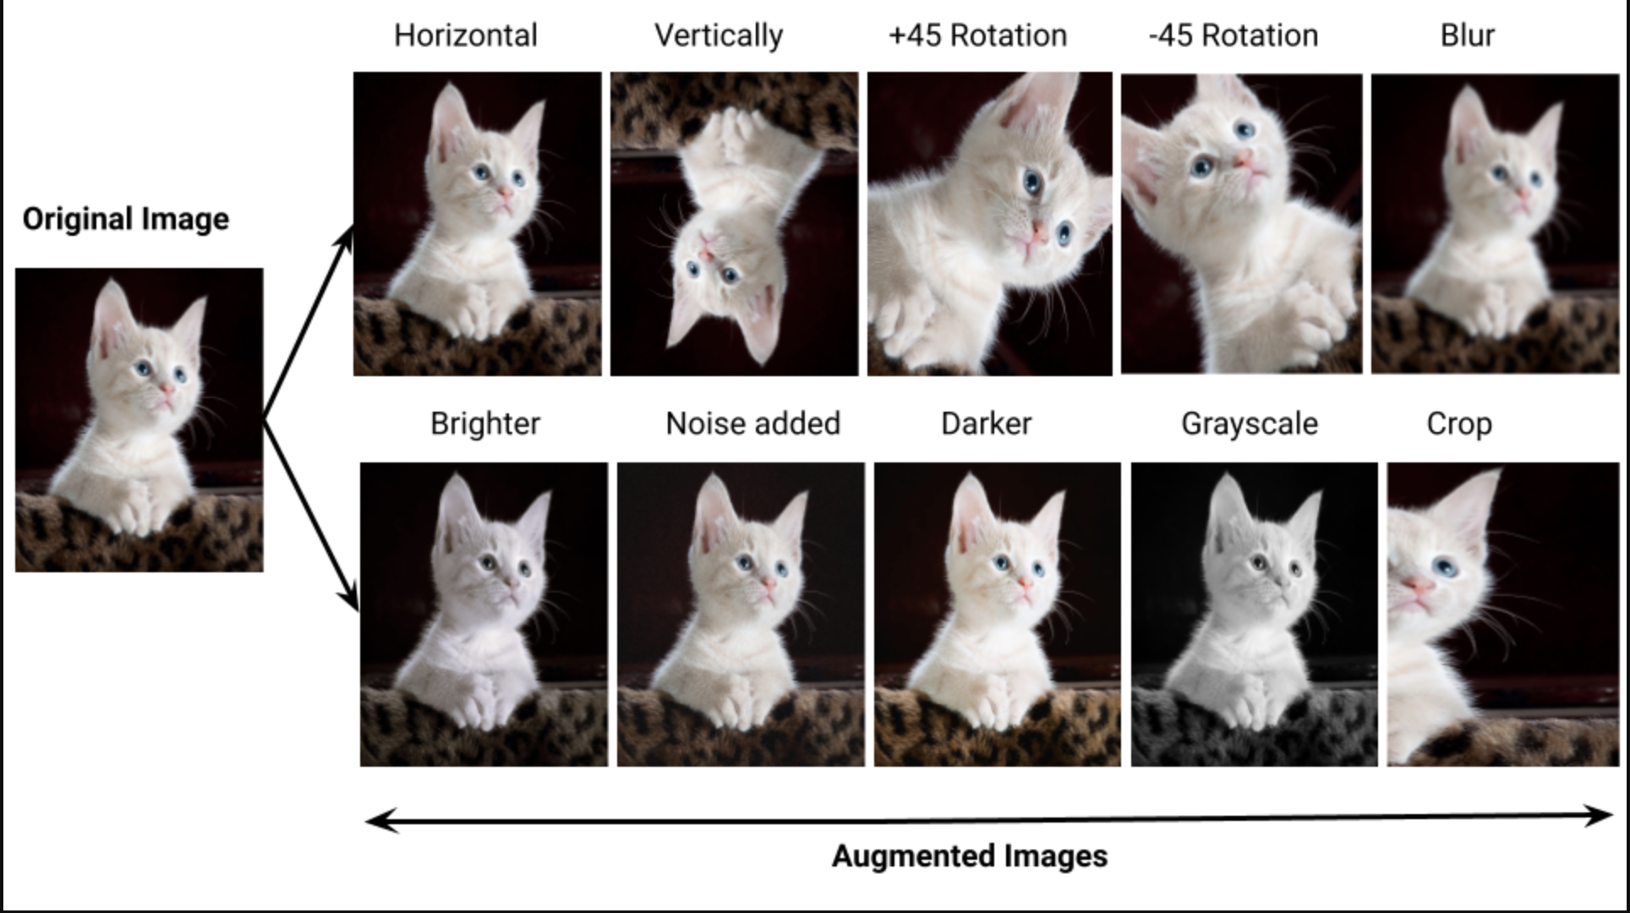
Why Pooling Helps
Source: https://medium.com/@tagxdata/data-augmentation-for-computer-vision-9c9ed474291e
Notes:
Another Good Resource: https://insightsimaging.springeropen.com/articles/10.1007/s13244-018-0639-9

Slide 14
Dense Layer
Flatten the neurons
Train a classifier on top of them
0
1
2
. . .
9
Input Layer
Convolution Layer
Pooling Layer
Dense Layer

Slide 15
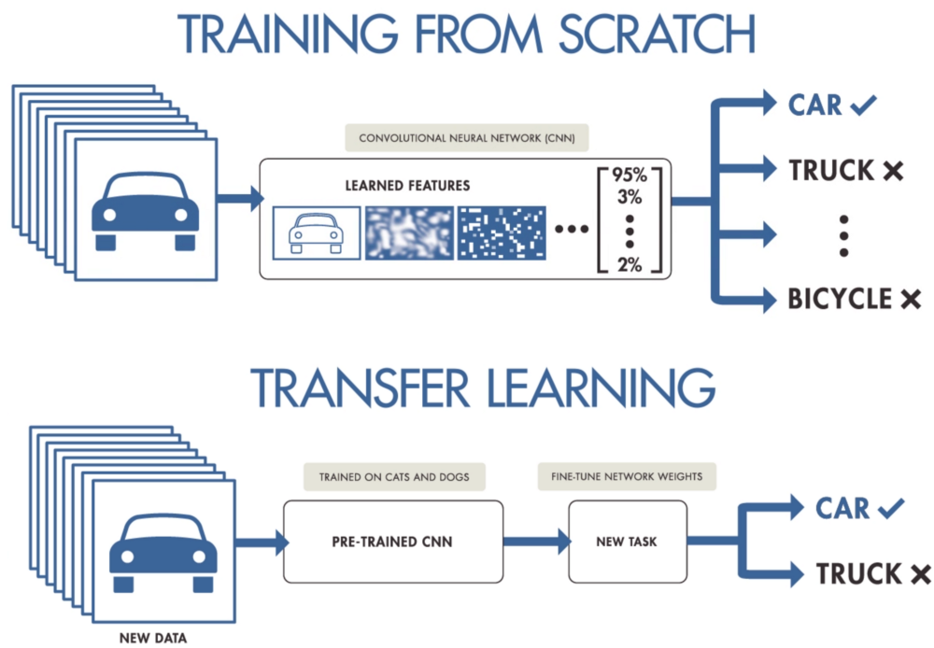
Pretrained Models & Transfer Learning
Image:employee-performance.com/blog/how-effective-performance-management-can-increase-companys-success/
Notes:
Excellent resource: https://machinelearningmastery.com/improve-deep-learning-performance/

Slide 16
Using Pre-trained Models
Apply knowledge learned from one task to another
We need less data to get more accurate results
Just focus on last layers
0
1
2
. . .
9
Input Layer
Reusable Feature Extraction Layers

Slide 17
Recurrent neural networks
From https://web.stanford.edu/~jurafsky/slp3/

Slide 18
Recurrent Neural Networks (RNNs)
Any network that contains a cycle within its network connections.
The value of some unit is directly, or indirectly, dependent on its own earlier outputs as an input.

Slide 19
Simple Recurrent Nets (Elman nets)
y_{t}
h_{t}
x_{t}
The hidden layer has a recurrence as part of its input
The activation value h_{t} depends on x_{t} but also h_{t-1}!

Slide 20
Forward inference in simple RNNs
Very similar to the feedforward networks we've seen!

Slide 21
Simple recurrent neural network illustrated as a feedforward network
Notes:
h_{t−1} from prior time step is multiplied by U and then added to the current time step's feedforward Wx_{t}

Slide 22
Inference has to be incremental
Computing h at time t requires that we first computed h at the previous time step!

Slide 23
Training in simple RNNs
Just like feedforward training:
training set,
a loss function,
backpropagation
Weights that need to be updated:
W, the weights from the input layer to the hidden layer,
U, the weights from the previous hidden layer to the current hidden layer,
V, the weights from the hidden layer to the output layer.

Slide 24
Training in simple RNNs: unrolling in time
Unlike feedforward networks:
1. To compute loss function for the output at time t we need the hidden layer from time t − 1.
2. hidden layer at time t influences the output at time t and hidden layer at time t+1 (and hence the output and loss at t+1).
So: to measure error accruing to h_{t},
need to know its influence on both the current output as well as the ones that follow.

Slide 25
RNN for language modeling

Slide 26
Predicting words
The water of Walden Pond is beautifully ...
blue
green
clear
*refrigerator
*that
Notes:
The intuition of language models lies in the task of predicting words. What word is likely to follow…? … But probably not "refrigerator" or "that".

Slide 27
Language Modeling

Slide 28
The size of the conditioning context for different LMs
The feedforward LM:
Context is the window size.
The RNN LM:
No fixed context size; h_{t-1} represents entire history

Slide 29
FFN LMs vs RNN LMs
…
FFN
RNN
Notes:
RNNs don’t have the limited context problem that n-gram models have, or the fixed context that feedforward language models have, since the hidden state can in principle represent information about all of the preceding words all the way back to the beginning of the sequence. Here's an FFN language model and an RNN language model, showing that the RNN language model uses ht−1, the hidden state from the previous time step, as a representation of the past context.

Slide 30
Training RNN LM
Self-supervision
take a corpus of text as training material
at each time step t
ask the model to predict the next word.
Why called self-supervised: we don't need human labels; the text is its own supervision signal
We train the model to
minimize the error
in predicting the true next word in the training sequence,
using cross-entropy as the loss function.

Slide 31
RNNs for sequence labeling
Assign a label to each element of a sequence
Part-of-speech tagging

Slide 32
RNNs for sequence classification
Text classification
Instead of taking the last state, could use some pooling function of all the output states, like mean pooling

Slide 33
Autoregressive generation

